Slide 1
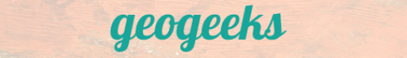
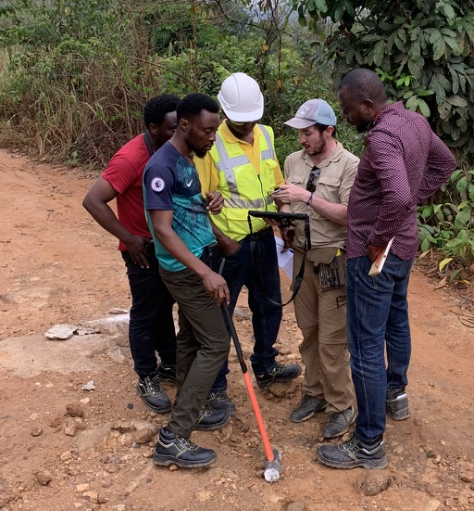


Towards the harmonization of digital field data entry for geological mapping: an in-house QGIS-QField-based template
Julien Perret (CET, UWA) - 05 July 2023
julien.perret@uwa.edu.au
© N.Thébaud – Sierra Leone, March 2023

Slide 2
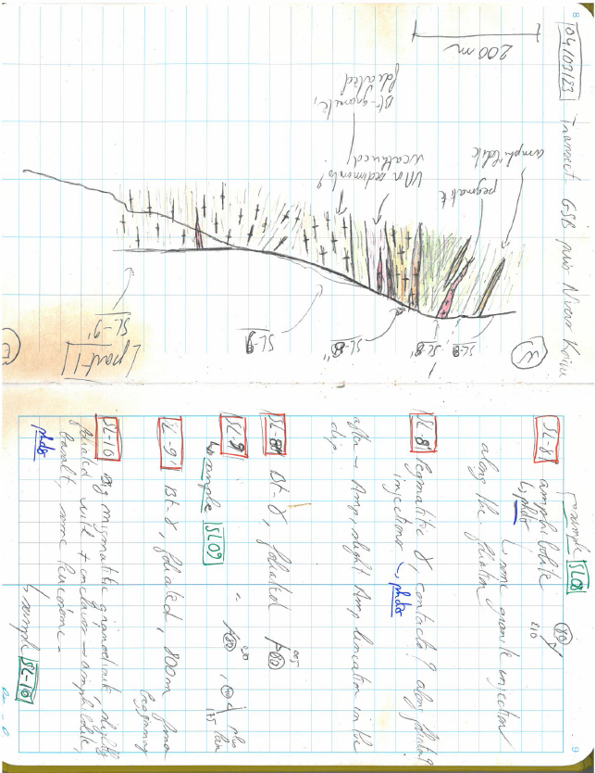
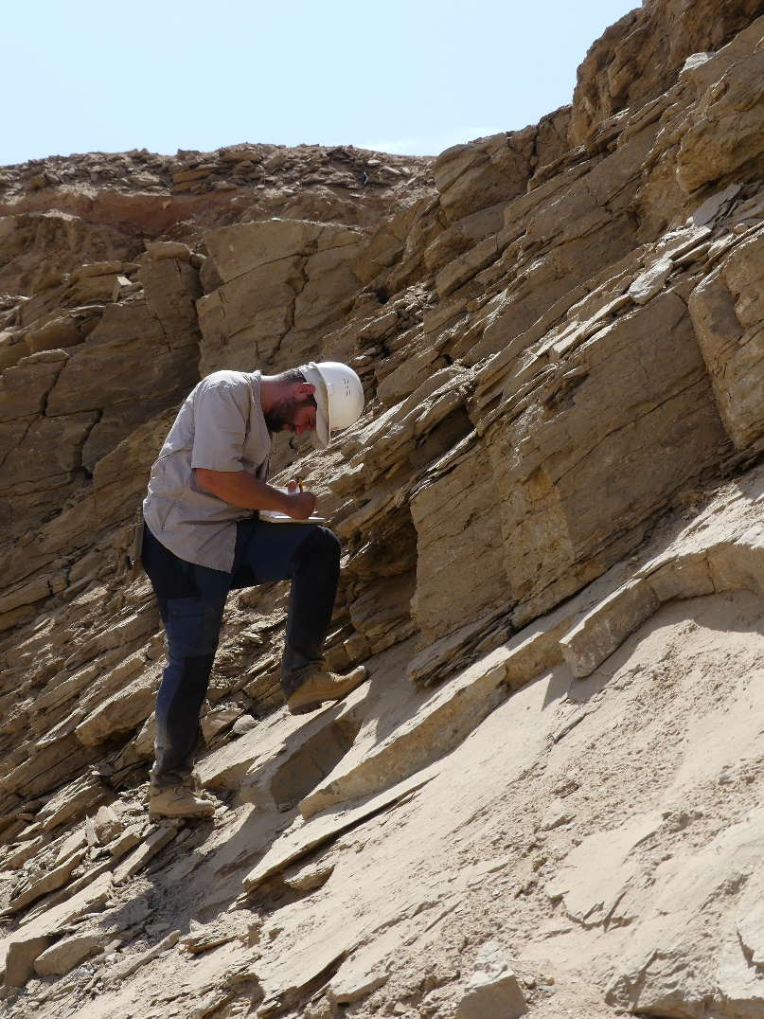
Introduction
© A.-S. André-Mayer –
Sudan, October 2019
Julien Perret’s fieldnotes –
Sierra Leone, March 2023
Conventional field data reporting uses pencil, paper and clipboard
Notes:
How to transfer data collected in the field to a digital geodatabase the most efficient way?
Challenge 1: using a single template to harmonise data collection from different people

Slide 3
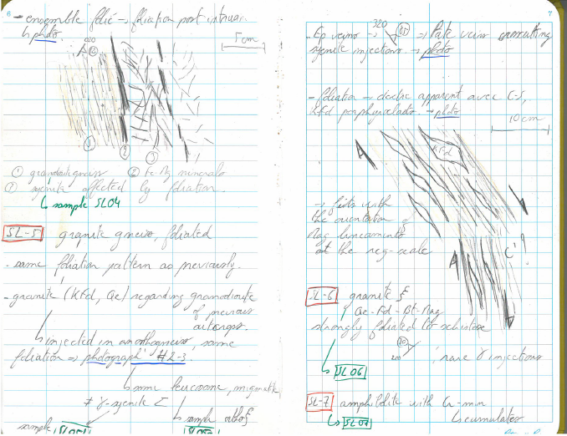
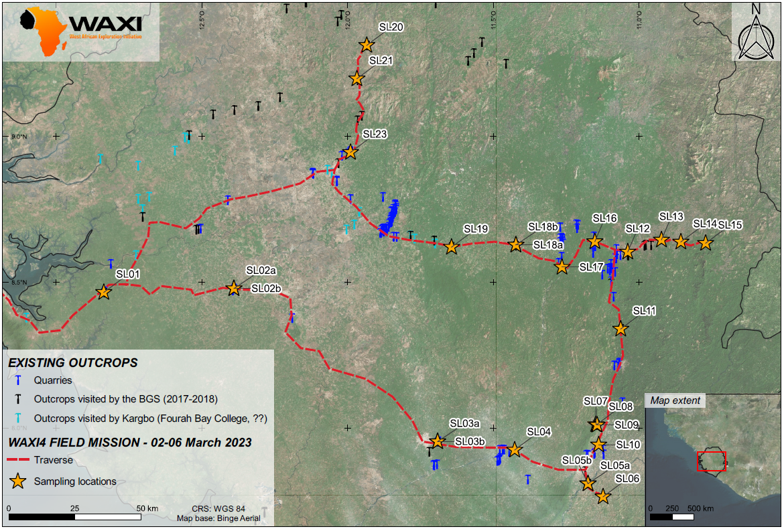
Introduction
Julien Perret’s field notes – Sierra Leone, March 2023
WAXI 4 – Sampling map, Sierra Leone field work, March 2023
From field notes...
... to georeferenced digital data
Notes:
How to transfer data collected in the field to a digital geodatabase the most efficient way?
Challenge 2: shifting from paper and clipboard to digital georeferenced data

Slide 4
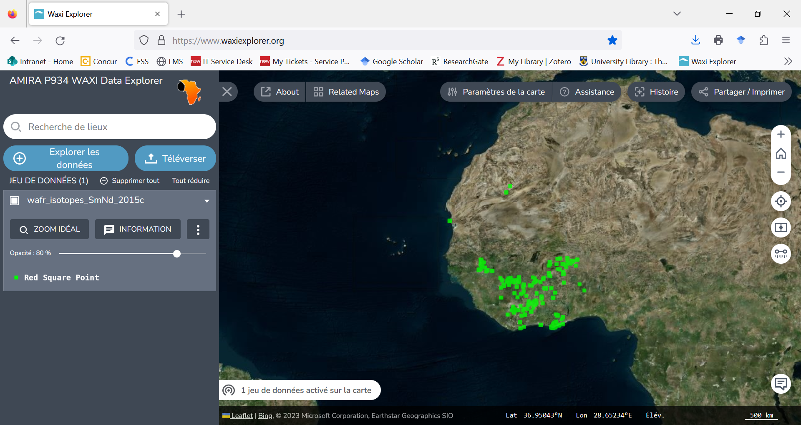
Introduction
A single group of geologists in a given location: easy process
Julien Perret’s field notes – Sierra Leone, March 2023
... to geodatabase building and sharing (Mark’s talk)
From field notes...
Notes:
How to transfer data collected in the field to a digital geodatabase the most efficient way?
Challenge 1: using a single template to harmonise data collection from different people

Slide 5
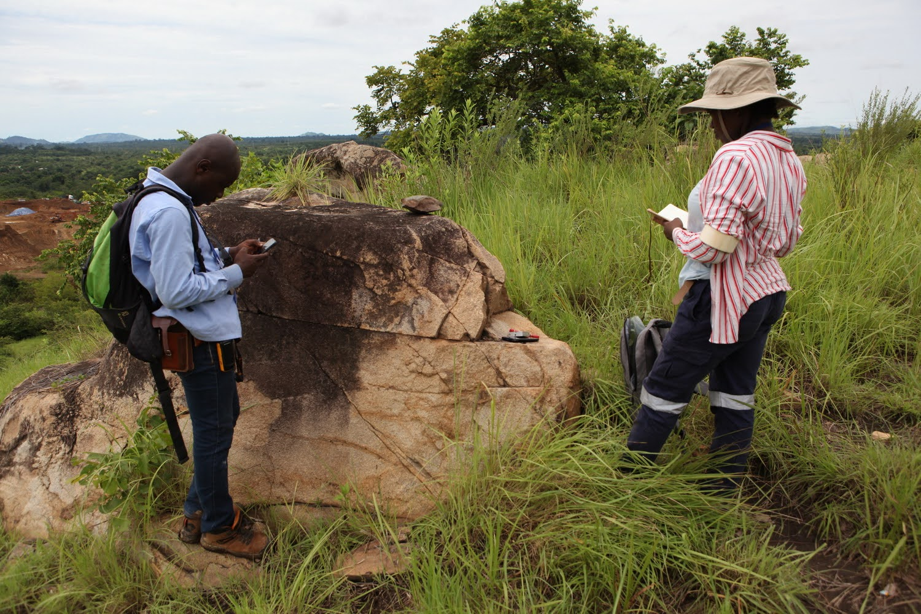
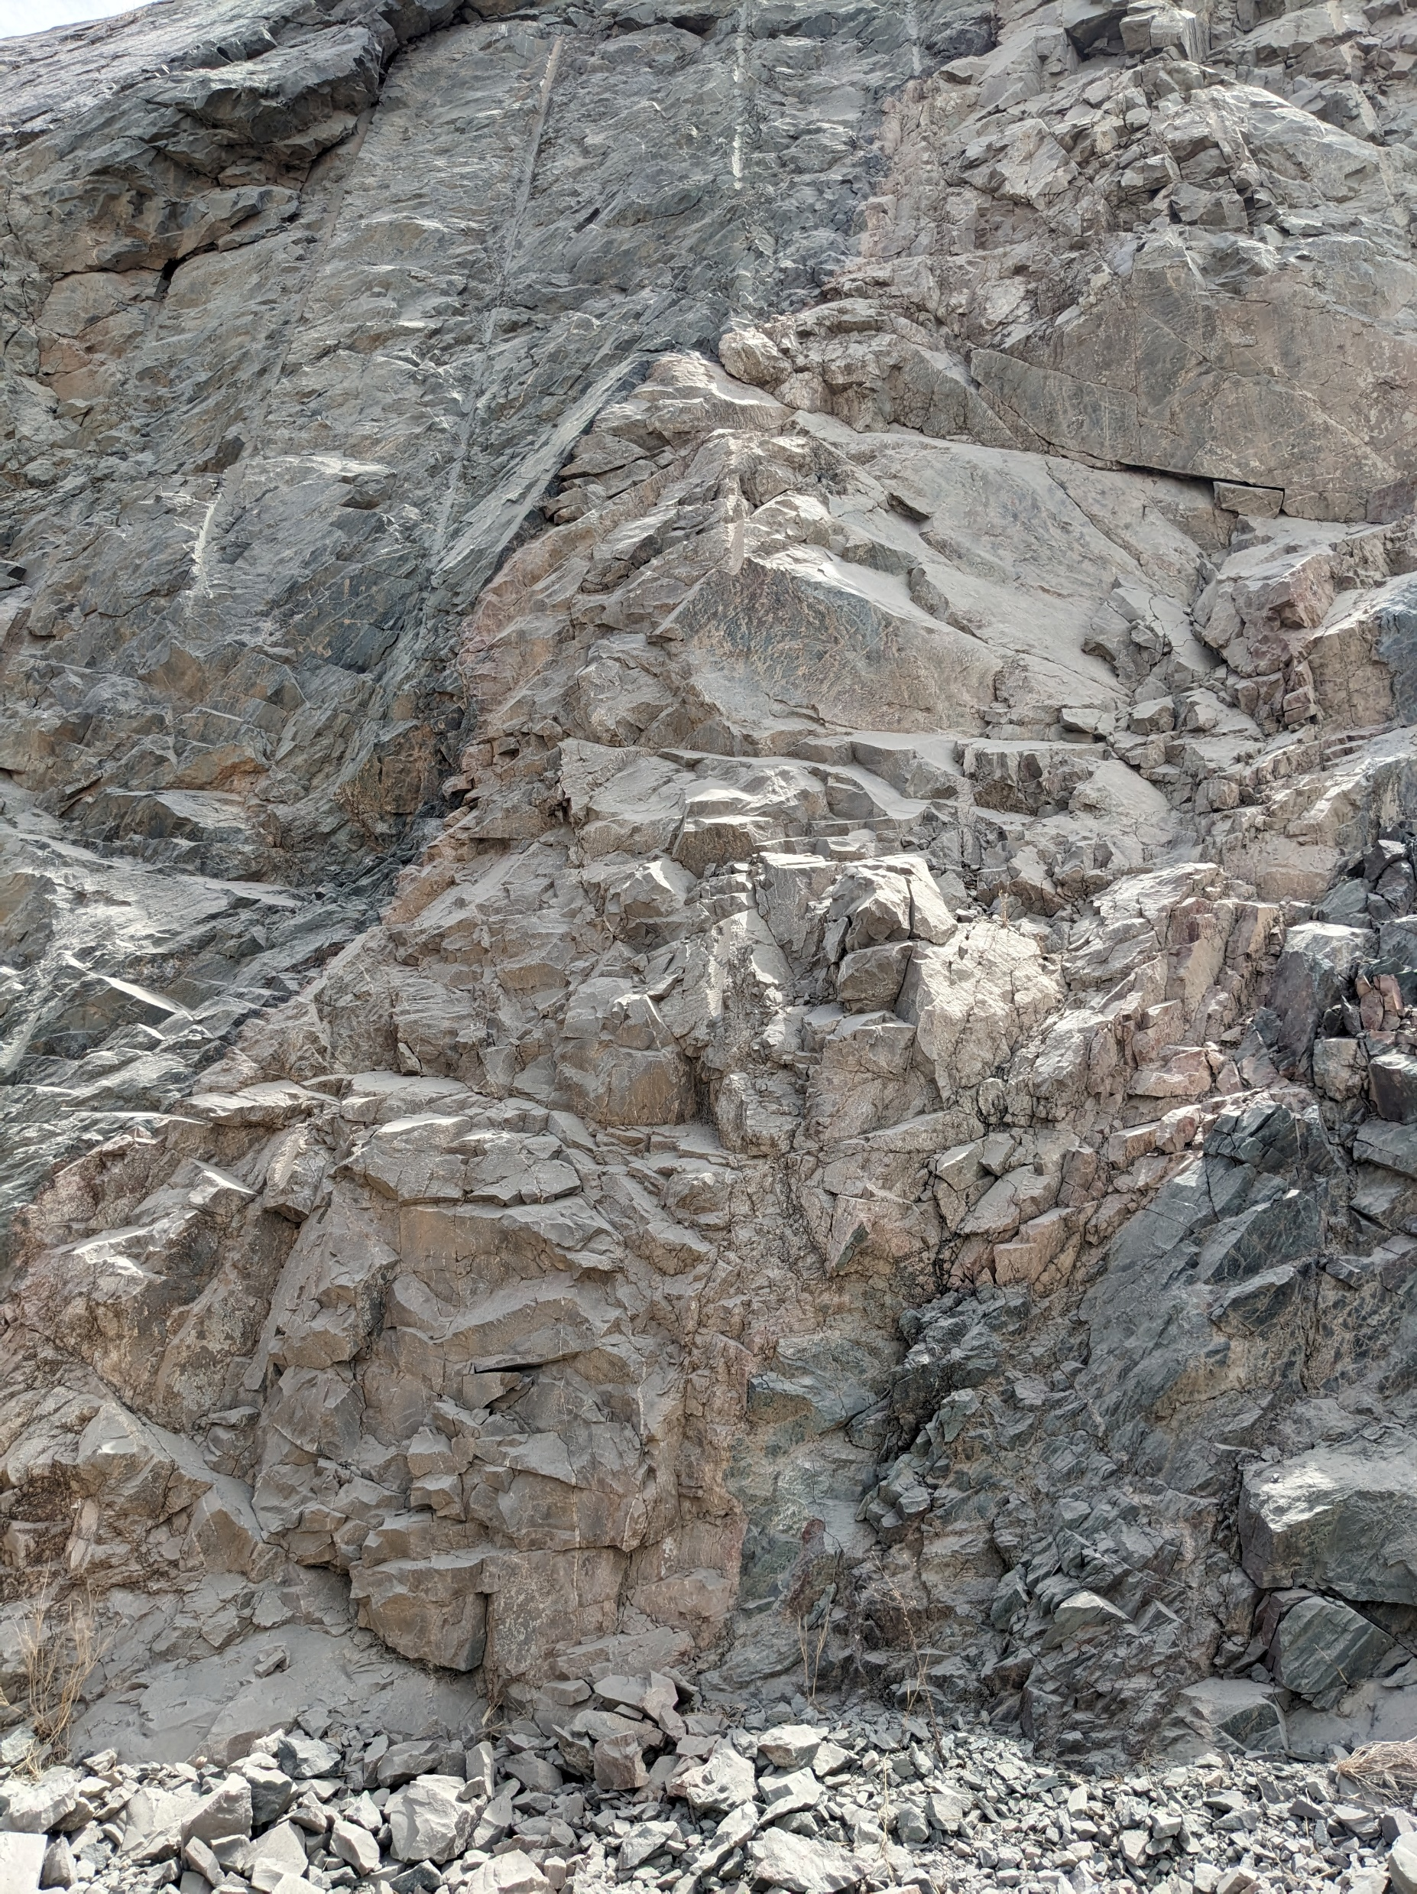
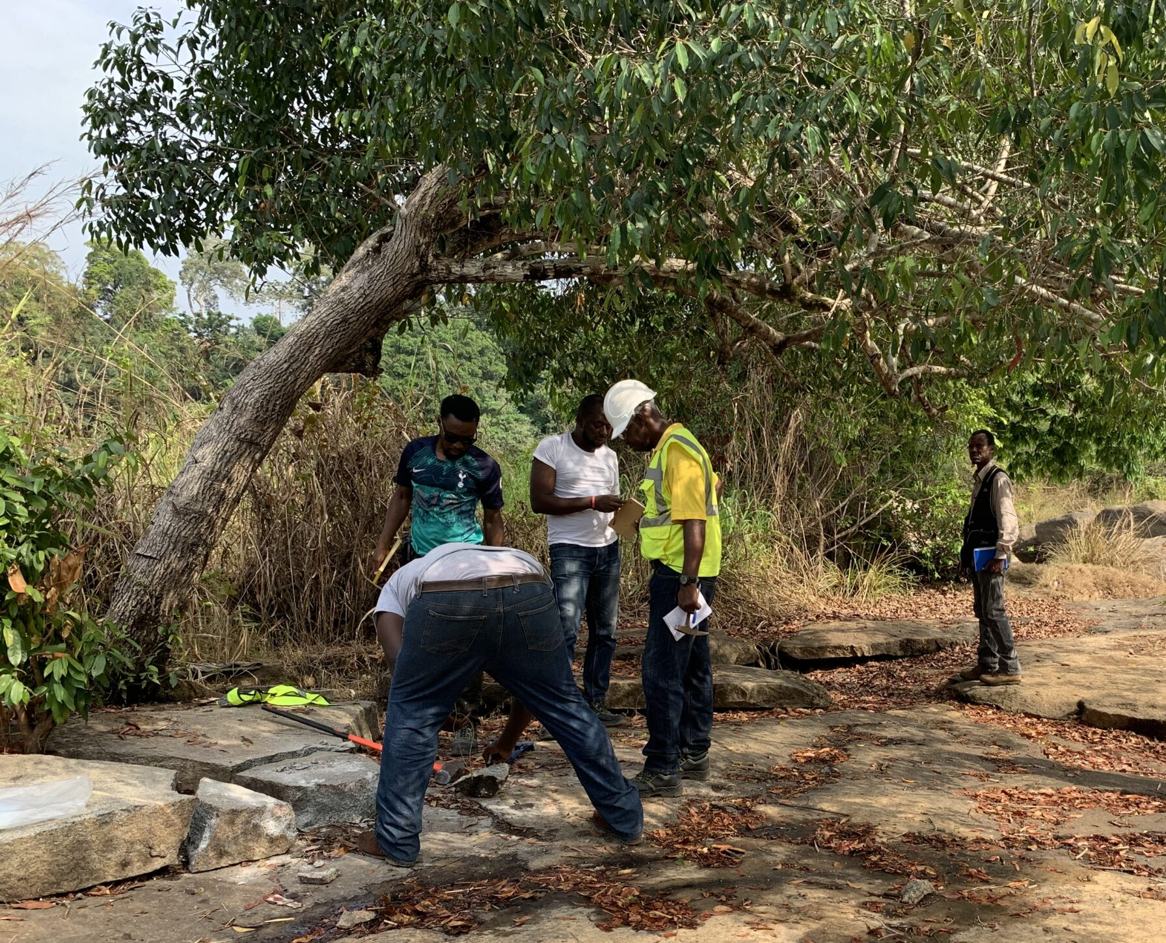
Introduction
Several groups of geologists in different locations: much trickier process
© J. Perret – Sénégal, May 2023
© L. Baratoux – Cote d’Ivoire, June 2023
... to geodatabase building and sharing (Mark’s talk)
From field data reporting
by different groups...
© N. Thébaud – Sierra Leone, March 2023
Notes:
How to transfer data collected in the field to a digital geodatabase the most efficient way?
Challenge 1: using a single template to harmonise data collection from different people
→ A real challenge at the scale of a collaborative program such as WAXI
GIS database gathering field observations and measurements already existing for several modules
→ 1.2 (Sub-surface struct analysis via geophy inversions using petrophysical constraints – Mark and Seta),
2.1 (Regional-scale structural architecture, tectonic and thermal evolution of the WAC – Lenka and Stéphane),
1.4 (Basin-basement structure – Prince, Daniel, Abigail and Mark)
3.4 (Metallogeny of the basins, Prince and Samuel)
Field data – outcrops will be described in different modules
1.1 (Archean crustal growth and lithospheric architecture – Nico and Alain),
1.3 (KKI, Architecture and significance of the Senegalo-Malia Discontinuity, Mahamadou and Lenka)
2.2 (Lithostratigraphy, Patrick)
2.3 (Relationships between granitoid gneisses and volcanosed belts in central Ivory Coast, Oscar) and 2.4 (Insights into the UB and B intrusive suites, Mathieu) → SRM 2: common interests with Patrick
3.1 (multi-scale architecture and mineral paragenesis of gold mineral systems, Nico) → direct insights into 3.2 (Petro-struct, geochro to decipher hydrothermal Au events) and 3.3 (Trace elements and isotopic fingerprinting of sulphides)
Use of large-scale outcrop and geophysical data in module 1.5 (entry data to assess for the plausibility of proposed geodynamic scenarii – Guillaume and Bakary)

Slide 6
Introduction
Several groups of geologists in different locations: much trickier process
© J. Perret – Sénégal, May 2023
Need for a comprehensive template enabling the digital report of field data and favoring:
a free, flexible and total control on the design of the field database,
post-field processing significantly faster,
much easier data compilation and data sharing with industrial and academic partners.
© L. Baratoux – Cote d’Ivoire, June 2023
... to geodatabase building and sharing (Mark’s talk)
From field data reporting
by different groups...
© N. Thébaud – Sierra Leone, March 2023
Notes:
How to transfer data collected in the field to a digital geodatabase the most efficient way?
Challenge 1: using a single template to harmonise data collection from different people
→ A real challenge at the scale of a collaborative program such as WAXI
GIS database gathering field observations and measurements already existing for several modules
→ 1.2 (Sub-surface struct analysis via geophy inversions using petrophysical constraints – Mark and Seta),
2.1 (Regional-scale structural architecture, tectonic and thermal evolution of the WAC – Lenka and Stéphane),
1.4 (Basin-basement structure – Prince, Daniel, Abigail and Mark)
3.4 (Metallogeny of the basins, Prince and Samuel)
Field data – outcrops will be described in different modules
1.1 (Archean crustal growth and lithospheric architecture – Nico and Alain),
1.3 (KKI, Architecture and significance of the Senegalo-Malia Discontinuity, Mahamadou and Lenka)
2.2 (Lithostratigraphy, Patrick)
2.3 (Relationships between granitoid gneisses and volcanosed belts in central Ivory Coast, Oscar) and 2.4 (Insights into the UB and B intrusive suites, Mathieu) → SRM 2: common interests with Patrick
3.1 (multi-scale architecture and mineral paragenesis of gold mineral systems, Nico) → direct insights into 3.2 (Petro-struct, geochro to decipher hydrothermal Au events) and 3.3 (Trace elements and isotopic fingerprinting of sulphides)
Use of large-scale outcrop and geophysical data in module 1.5 (entry data to assess for the plausibility of proposed geodynamic scenarii – Guillaume and Bakary)

Slide 7
Introduction
Several groups of geologists in different locations: much trickier process
© J. Perret – Sénégal, May 2023
Development of a GIS-based template for field data collection:
facilitating data compilation into a GIS-based repository,
direct access on field to georeferenced data when implemented in the project (geological / geophysical maps, former field work data, geochronological / geochemical datasets, etc...),
diminution of post-field processing time spent to edit and homogenise data,
less georeferencing issues, e.g., missing GPS datapoints, misreporting of coordinates, missing CRS information, etc...
© L. Baratoux – Cote d’Ivoire, June 2023
... to geodatabase building and sharing (Mark’s talk)
From field data reporting
by different groups...
© N. Thébaud – Sierra Leone, March 2023
Notes:
How to transfer data collected in the field to a digital geodatabase the most efficient way?
Challenge 1: using a single template to harmonise data collection from different people
→ A real challenge at the scale of a collaborative program such as WAXI
GIS database gathering field observations and measurements already existing for several modules
→ 1.2 (Sub-surface struct analysis via geophy inversions using petrophysical constraints – Mark and Seta),
2.1 (Regional-scale structural architecture, tectonic and thermal evolution of the WAC – Lenka and Stéphane),
1.4 (Basin-basement structure – Prince, Daniel, Abigail and Mark)
3.4 (Metallogeny of the basins, Prince and Samuel)
Field data – outcrops will be described in different modules
1.1 (Archean crustal growth and lithospheric architecture – Nico and Alain),
1.3 (KKI, Architecture and significance of the Senegalo-Malia Discontinuity, Mahamadou and Lenka)
2.2 (Lithostratigraphy, Patrick)
2.3 (Relationships between granitoid gneisses and volcanosed belts in central Ivory Coast, Oscar) and 2.4 (Insights into the UB and B intrusive suites, Mathieu) → SRM 2: common interests with Patrick
3.1 (multi-scale architecture and mineral paragenesis of gold mineral systems, Nico) → direct insights into 3.2 (Petro-struct, geochro to decipher hydrothermal Au events) and 3.3 (Trace elements and isotopic fingerprinting of sulphides)
Use of large-scale outcrop and geophysical data in module 1.5 (entry data to assess for the plausibility of proposed geodynamic scenarii – Guillaume and Bakary)

Slide 8
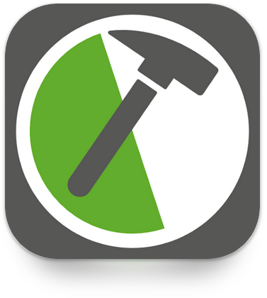




Introduction
Notes:
FYI: Links to app description webpages attached to logos.
Existing apps for field data collection, some pros and cons (among others)
→ Their main issue relies on the lack of flexibility and/or export options to make them as comprehensive as wished and/or facilitate data export into a GIS-based repository.

Slide 9
Introduction
Arc Field Maps
ESRI support to customise a project the most convenient way,
collaborative platform,
direct sync to ArcGIS.
Cost of licences.
QField
Free, easy to share with partners,
flexible to set up / optimise,
collaborative platform (QFieldCloud),
direct sync to QGIS.
Need for QGIS know-how and a fair amount of time to properly set up and customise attributes form and edit styling.
Notes:
FYI: Links to app description webpages attached to logos.
Advantages of QField-QGIS over ArcGIS Field Maps-ArcGIS:
free of charge,
easy installation,
lot of plugins and extensions reliable and constantly updated (notably, the conversion from ArcGIS files to QGIS files and symbologies is possible !)
Abundant documentation (manual and tutorials) + blogs → GeoRezo, an huge community
you can basically do whatever you want, very flexible and versatile depending on what you need,
Direct relationship to QGIS, meaning that data transfer to the geodatabase is very straight forward and you benefit of every options offered by QGIS to deal with your data quasi instantaneously → data compilation, map creation, export to an online database, etc...

Slide 10
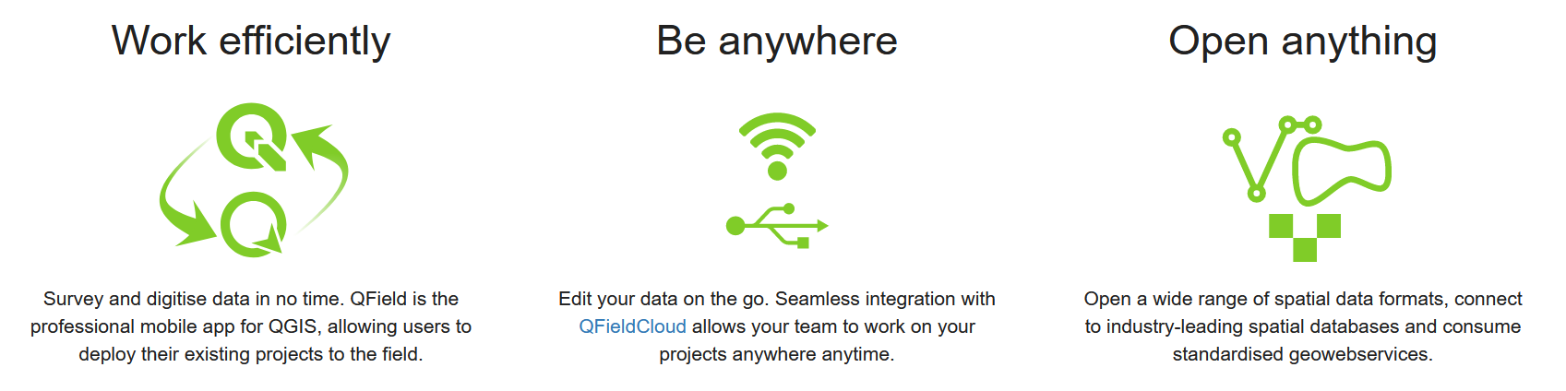
QGIS-based QField app
In a few words…
© QField website
Notes:
FYI: Link to QField website attached to logo in right-hand corner.
Advantages of QField-QGIS over ArcGIS Field Maps-ArcGIS:
free of charge,
easy installation,
lot of plugins and extensions reliable and constantly updated (notably, the conversion from ArcGIS files to QGIS files and symbologies is possible !)
Abundant documentation (manual and tutorials) + blogs → GeoRezo, an huge community
you can basically do whatever you want, very flexible and versatile depending on what you need,
Direct relationship to QGIS, meaning that data transfer to the geodatabase is very straight forward and you benefit of every options offered by QGIS to deal with your data quasi instantaneously → data compilation, map creation, export to an online database, etc...

Slide 11



QGIS-based QField app
Installation of QGIS software and QField app
QGIS
QField
Notes:
FYI: Link to QField website attached to logo in right-hand corner + Links to QGIS download webpage and QField download in Android and iOS playstores attached to logos
QGIS desktop need to be installed in your computer and QField app on your mobile device (Android or iOS)

Slide 12
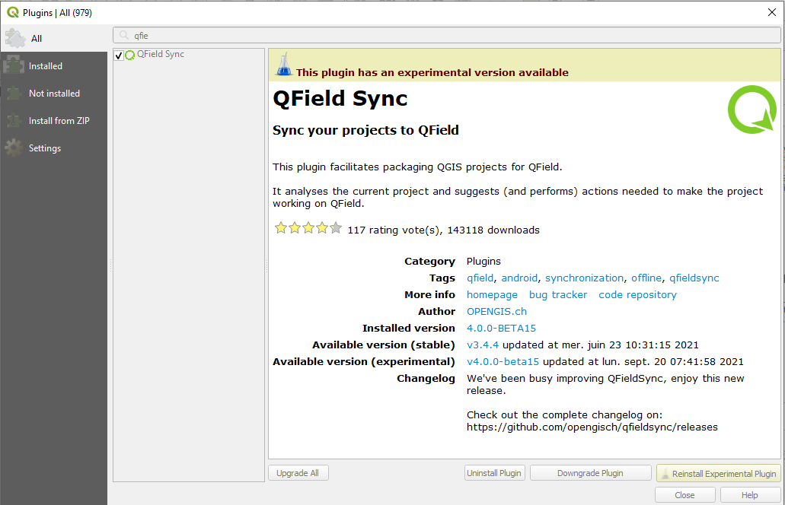
QGIS-based QField app
QField Sync plugin
Notes:
FYI: Link to QField website attached to logo in right-hand corner
If you want Open QGIS and install the QField Sync plugin from the Plugins tab.

Slide 13
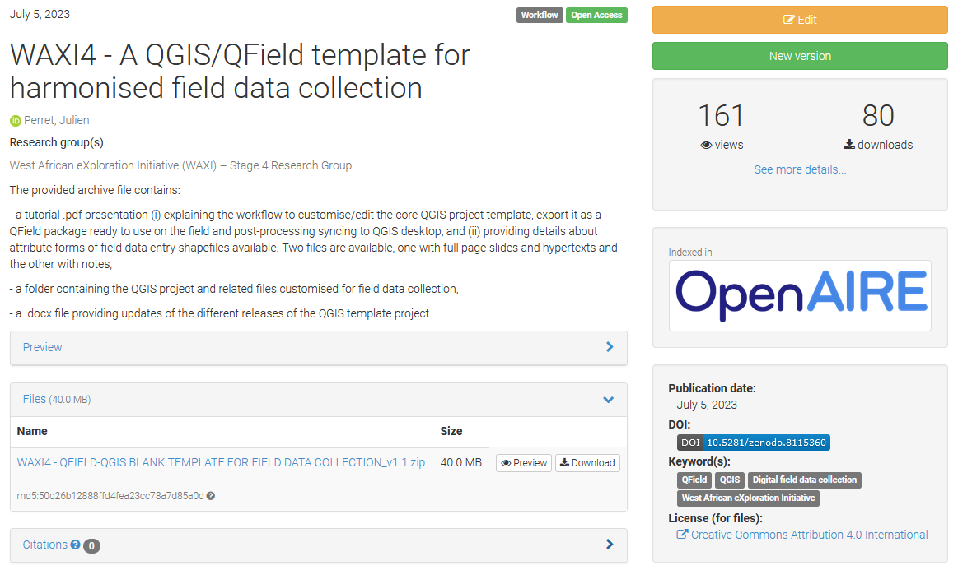
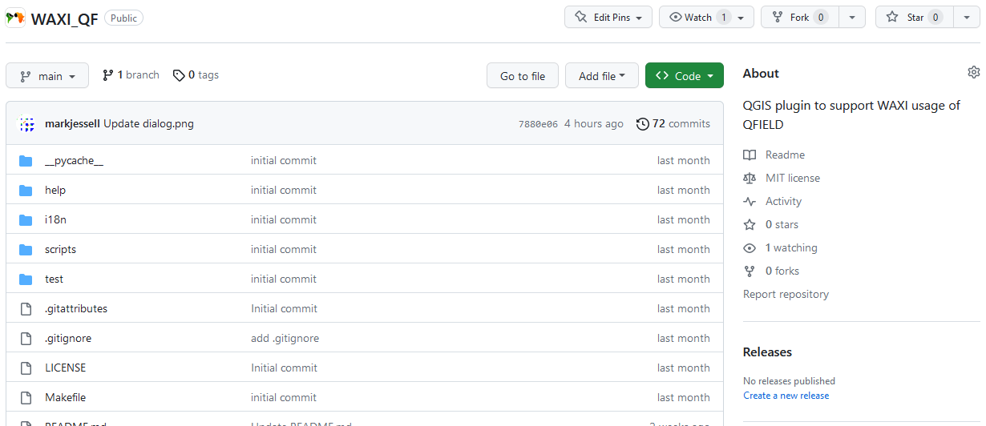
Proposed template – Demo
Blank QGIS project and related files – last release = v1.1 (Zenodo repository)
Extra options via the WAXI_QF QGIS plugin developed by Mark Jessell

Slide 14
Now it’s your turn!
Feel free to join the team: give it a try and provide us with feedback!
Execution at the office: are the tutorials straight-forward enough to facilitate the combined use of QGIS desktop and QField app?
Execution on the field: what could be improved to make your QField experience more user-friendly and/or more efficient?
Accuracy and comprehensiveness of attribute forms:
any missing information you would like to add as an attribute? Any missing attribute form?,
what items could be added/deleted in drop-down lists? What are your preferred nomenclatures to describe textures, structures, deformation patterns, etc...?
FEEDBACKS FROM DIFFERENT USERS ARE NOW NEEDED AND WILL GREATLY ASSIST IN IMPROVING THE TEMPLATE!

